Slide 1

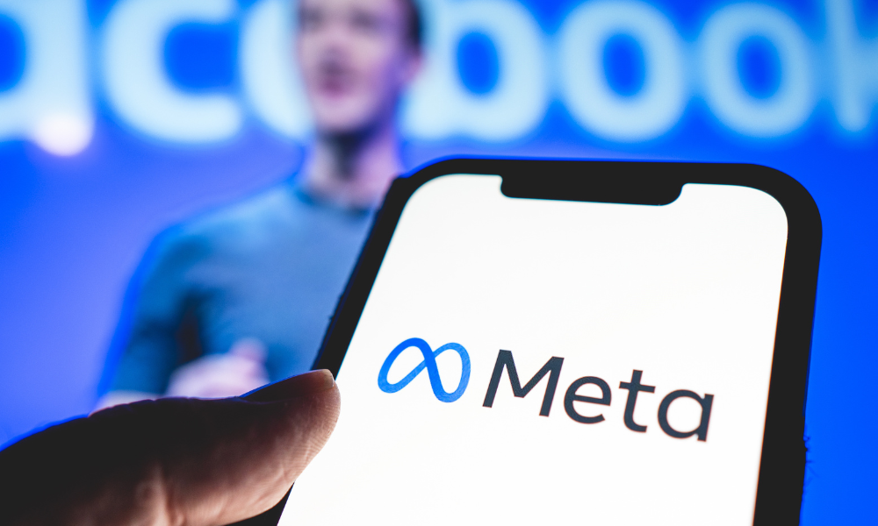

K
D
J
C
I
E
F
G
A
B
H
COMPETITIVE ADVANTAGE
STRATEGIC ALIGNMENT
MARKET OPPORTUNITY
EXECUTIVE SUMMARY
PROBLEM STATEMENT
SOLITION OVERVIEW
RISK MITIGATION
REVENUE MODEL
CALL to ACTION
COST ANALYSIS and INVESTMENT
SCALABILITY and ROI Beyond 10 years
MOBILE-FRIENDLY IMMERSIVE
E-COMMERCE
FOR META
Static e-commerce experiences limit engagement.
AR/VR technologies are inaccessible to most SMEs.
Users lack interactive shopping options on mobile devices.
CATEGORY | COST (IN USD)
Research and Development | $9.5M
Infrastructure and Technology | $9.5M
Marketing and SME Onboarding | $9.5M
Operational Costs | $19.5M
Miscellaneous and Contingency | $7M
Grand Total | $55M
META’S EDGE
Comprehensive Ecosystem - Facebook, Instagram, and WhatsApp
Mobile-Friendly AR/VR
Social Commerce Integration
User Data Insights
Expand into Southeast Asia, Latin America, and Africa
Introduce AI powered generative commerce tools
Enhance AR personalization and VR marketplace experiences
USER FLOW DIAGRAM
FEATURE | META | AMAZON | SHOPIFY | GOOGLE
Mobile AR/VR Focus | ✔ | Limited | Limited | Limited
SME Integration | ✔ | ✔ | ✔ | Minimal
Platform Ecosystem | ✔ | ✔ | ✔ | Minimal
I invite Meta to:
Review this proposal to explore its potential impact on Meta’s platforms and e-commerce strategy.
Schedule a meeting to discuss the proposed solution in greater detail and evaluate its alignment with Meta’s goals.
By embracing this initiative, Meta can unlock new opportunities, enhance user engagement, and strengthen its position as a global leader in AR/VR and e-commerce.
Please feel free to contact me at harithdevinda8@gmail.com or +94703359228 to arrange a follow-up discussion or presentation. I am confident this collaboration will pave the way for groundbreaking innovation.
CHALLANGES
STREAM | MECHANICS | ANNUAL REVENUE
SME Subscriptions | 5 million businesses subscribing at $100/month | $6B
Transaction Fees | 2% transaction fee on Meta’s projected share of the global e-commerce market | $14B
AR Ad | 1% of Meta’s active users (30M) engage with immersive ads, with an average ad spend of $10/user | $300M
Total |  | $20.3B
Slow Adoptation of AR/VR by SMEs
Limited User Engagement With Immersive Ads
Technological Barriers In Emerging Markets
Competition From Established Platforms
Privacy And Data Security Concerns
High Initial Development Costs
Slow Roi Realization
UPLOAD 2D IMAGES
AI GENERATES 3D MODELS
USERS INTERACT VIA MOBILE
KEY FEATURES
AI-powered 2D to 3D conversion.
AR product visualization optimized for smartphones.
Seamless integration with Facebook Shops and Instagram Shopping.
CURRENT
Revolutionizing online shopping with AR/VR optimized for mobile devices.
Empowering SMEs with AI-powered tools for 3D model creation.
Projected revenue potential: $20.3B+ annually.
Advancing The Metaverse
Increasing Global User Engagement
Leveraging AR/VR For Broader Applications
Emerging Markets
Vertical Applications
AR/VR Innovation
TARGETED AUDIENCE
IMPACT OF SOLVING
6
12
18
SMEs
TECH-SAVVY CONSUMERS
MOBILE SHOPPERS
Solving these issues enhances Meta’s
Platforms
User Engagement
SME support
Research and Development | Beta Testing | Global Rollout | Continuous Improvement
Market Value (Trillion USD)
INNOVATION
AI-Driven 3D Model Generation
Affordability and Accessibility
Mobile-First Approach
Seamless Integration with Existing Tools
0
18+
($B)
Annual Revenue ($B)
META
Presented by: K.D.A. Harith Devinda Rajapaksha
E-mail: harithdevinda8@gmail.com
Phone Number: +940703359228
Date: January 2025
OPPORTUNITIES TO CAPITALIZE
Dominate the SME Market
Enhance User Engagement
Partner with Advertisers
Expand in Emerging Markets
Meta’s Edge:
Comprehensive AR/VR and mobile-first integration.
The global e-commerce market is projected to reach over $7 trillion by 2027.
AR-enabled shopping can boost conversion rates by up to 40%.
10-Year Cumulative Revenue Projection: $203B

Slide 2
A
EXECUTIVE SUMMARY
Revolutionizing online shopping with AR/VR optimized for mobile devices.
Empowering SMEs with AI-powered tools for 3D model creation.
Projected revenue potential: $20.3B+ annually.

Slide 3
B
PROBLEM STATEMENT
Static e-commerce experiences limit engagement.
AR/VR technologies are inaccessible to most SMEs.
Users lack interactive shopping options on mobile devices.
CHALLANGES
CURRENT
IMPACT OF SOLVING
Solving these issues enhances Meta’s
Platforms
User Engagement
SME support

Slide 4
C
SOLITION OVERVIEW
USER FLOW DIAGRAM
KEY FEATURES
AI-powered 2D to 3D conversion.
AR product visualization optimized for smartphones.
Seamless integration with Facebook Shops and Instagram Shopping.
UPLOAD 2D IMAGES
AI GENERATES 3D MODELS
USERS INTERACT VIA MOBILE
6
12
18
Research and Development | Beta Testing | Global Rollout | Continuous Improvement
0
18+

Slide 5
D
MARKET OPPORTUNITY
META’S EDGE
Comprehensive Ecosystem - Facebook, Instagram, and WhatsApp
Mobile-Friendly AR/VR
Social Commerce Integration
User Data Insights
TARGETED AUDIENCE
SMEs
TECH-SAVVY CONSUMERS
MOBILE SHOPPERS
Market Value (Trillion USD)
INNOVATION
AI-Driven 3D Model Generation
Affordability and Accessibility
Mobile-First Approach
Seamless Integration with Existing Tools
OPPORTUNITIES TO CAPITALIZE
Dominate the SME Market
Enhance User Engagement
Partner with Advertisers
Expand in Emerging Markets
The global e-commerce market is projected to reach over $7 trillion by 2027.
AR-enabled shopping can boost conversion rates by up to 40%.

Slide 6
E
COMPETITIVE ADVANTAGE
FEATURE | META | AMAZON | SHOPIFY | GOOGLE
Mobile AR/VR Focus | ✔ | Limited | Limited | Limited
SME Integration | ✔ | ✔ | ✔ | Minimal
Platform Ecosystem | ✔ | ✔ | ✔ | Minimal
Meta’s Edge:
Comprehensive AR/VR and mobile-first integration.

Slide 7
F
SCALABILITY and ROI Beyond 10 years
Expand into Southeast Asia, Latin America, and Africa
Introduce AI powered generative commerce tools
Enhance AR personalization and VR marketplace experiences
Annual Revenue ($B)

Slide 8
G
REVENUE MODEL
STREAM | MECHANICS | ANNUAL REVENUE
SME Subscriptions | 5 million businesses subscribing at $100/month | $6B
Transaction Fees | 2% transaction fee on Meta’s projected share of the global e-commerce market | $14B
AR Ad | 1% of Meta’s active users (30M) engage with immersive ads, with an average ad spend of $10/user | $300M
Total |  | $20.3B
10-Year Cumulative Revenue Projection: $203B

Slide 9
H
COST ANALYSIS and INVESTMENT
CATEGORY | COST (IN USD)
Research and Development | $9.5M
Infrastructure and Technology | $9.5M
Marketing and SME Onboarding | $9.5M
Operational Costs | $19.5M
Miscellaneous and Contingency | $7M
Grand Total | $55M
($B)

Slide 10
I
RISK MITIGATION
Slow Adoptation of AR/VR by SMEs
Limited User Engagement With Immersive Ads
Technological Barriers In Emerging Markets
Competition From Established Platforms
Privacy And Data Security Concerns
High Initial Development Costs
Slow Roi Realization

Slide 11
J
STRATEGIC ALIGNMENT
Advancing The Metaverse
Increasing Global User Engagement
Leveraging AR/VR For Broader Applications
Emerging Markets
Vertical Applications
AR/VR Innovation

Slide 12
K
CALL to ACTION
I invite Meta to:
Review this proposal to explore its potential impact on Meta’s platforms and e-commerce strategy.
Schedule a meeting to discuss the proposed solution in greater detail and evaluate its alignment with Meta’s goals.
By embracing this initiative, Meta can unlock new opportunities, enhance user engagement, and strengthen its position as a global leader in AR/VR and e-commerce.
Please feel free to contact me at harithdevinda8@gmail.com or +94703359228 to arrange a follow-up discussion or presentation. I am confident this collaboration will pave the way for groundbreaking innovation.

